Slide 1
GOMC Campaign Presentation - ResearchFox
Group 6
Uttam Bharadwaj· Vishnu Kumar· Lakshmi durga
Abhiraj malappa· Sushant deshmukh· Rohit Khanna

Slide 2
ResearchFox
Bangalore based market research firm.
Officially incorporated in 2012.
Start-Up with 25-50 employees.
Provide data and first-hand reports on a large number of industries.
Specialize in market intelligence reporting and business consulting services.
Has offices in Bangalore and Hyderabad.

Slide 3
Features of Pre-Campaign Report
The goal of the campaigns is to increase awareness about our client.
We planned to have 3 campaigns in total
Branding with a 40% split of the budget
Products with a 30% split of the budget
Reporting with a 30% split of the budget
Main KPIs were chosen as getting a CTR of 1% and increasing the number of leads for the company.

Slide 4
Learnings From Initial Execution
Initially realized the AdRank was low for ads.
One of the products in the Product campaign was achieving great results, while the other was not getting any clicks.
Customer Attribution Tracking was hard to implement immediately due to time difference between us and the client.
Dynamic Keyword Ads were performing better than normal Ads.
Most of our clicks came from the Display Network Ads.

Slide 5
Updates And Optimizations
Campaign budgets were allocated dynamically depending on ad performance
Added negative keywords to reduce wasted clicks on our ads.
Added a new ad group to the Products Campaign for Social Media, which performed very well, getting 783 clicks with a 1.75% CTR.
Changed the call to action for Ads to have the “Free” earlier in the description resulting in higher CTRs.
Narrowed the locations targeted to India to generate more positive leads for the client.

Slide 6
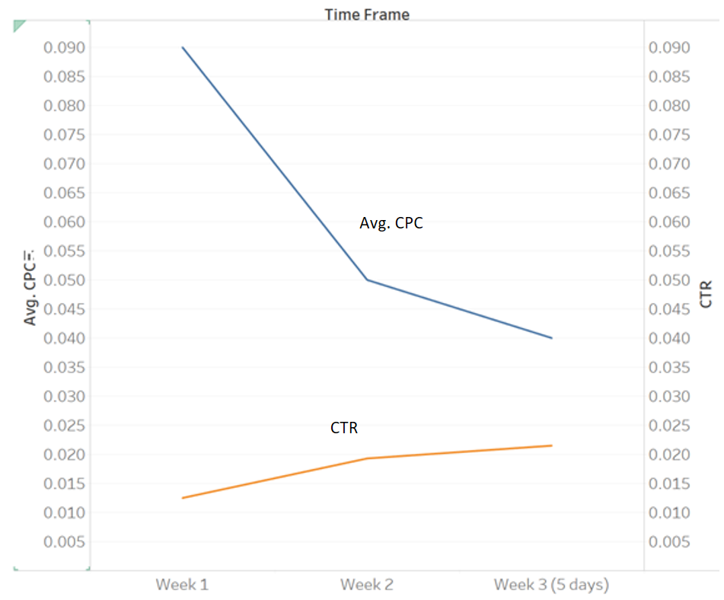
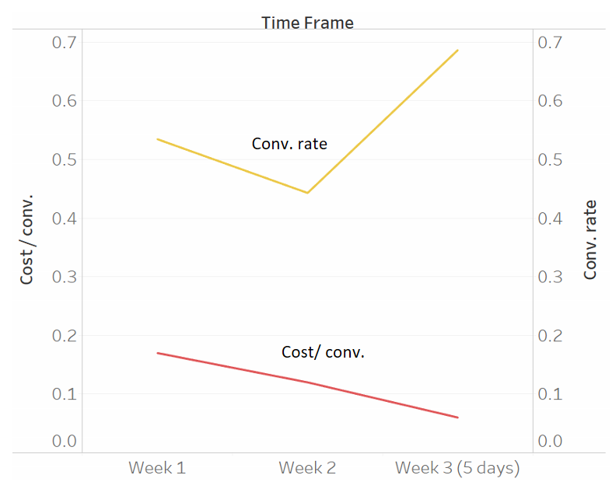
Performance Summary
Time Frame | Impressions | Clicks | CTR | Avg. CPC | Cost US$ | Avg. position | Cost / conv.
Week 1 | 56,002 | 699 | 1.25% | US$0.09 | 65.1 | 1.45 | US$0.17
Week 2 | 111,597 | 2,149 | 1.93% | US$0.05 | 113.74 | 1.61 | US$0.12
Week 3 | 81,013 | 1,745 | 2.15% | US$0.04 | 71.59 | 1.77 | US$0.06
Totals | 248,612 | 4,593 | 1.84% | US$0.05 | 239 | 1.6 | US$0.10

Slide 7
Experiences And Learning
We were unable to implement Google Analytics in the ResearchFox website to track customer behavior.
We had a large conversion rate on some of the ad campaigns due to the conversion attribution code being placed wrongly by the webmaster. We were unable to fix the issue till the end of the project.
Conversion rate was properly accurate mainly on the Products page as we had a clear page to reach to consider as a conversion.

Slide 8
Thanks! Questions?

